Slide 1
JiTT
By Just in Time Ultimate

Slide 2
Project Overview
Object-Oriented Design
Data-Centered Architecture
MySQL Database
Database Architecture is 3rd normal form
Final Language Used: C#
Git Version Control
IDE’s are wonderful

Slide 3
Phase I
Defined the Requirements of the Software
Project Design
Data-Centered
Process Model
Waterfall
Project Management Method
Self-Directed Work Team
Language
C++

Slide 4
Phase II
Created the Class Diagram
Decided Final Feature List
Created Sequence Diagrams
Divided project into Parts

Slide 5
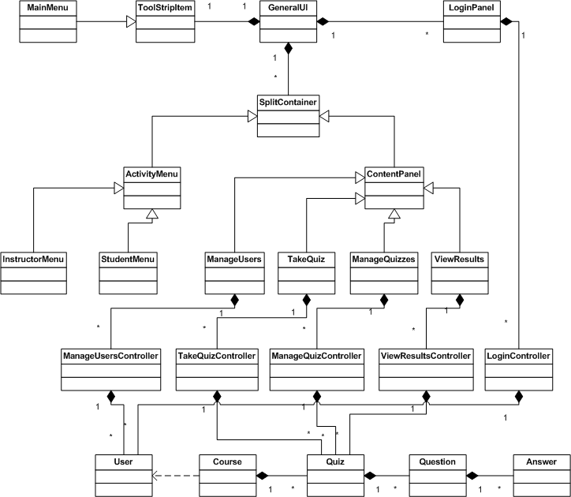
Phase II Class Diagram

Slide 6
Phase III
Threw away all material from Phase I and II
Change Process Model to Extreme Programming
Used Git and GitHub to share files
Used Google Chat to communicate while working when unable to meet in the same place
Met more often and longer at times
Changed Language to C#
Rich with features that aid in quick programming

Slide 7
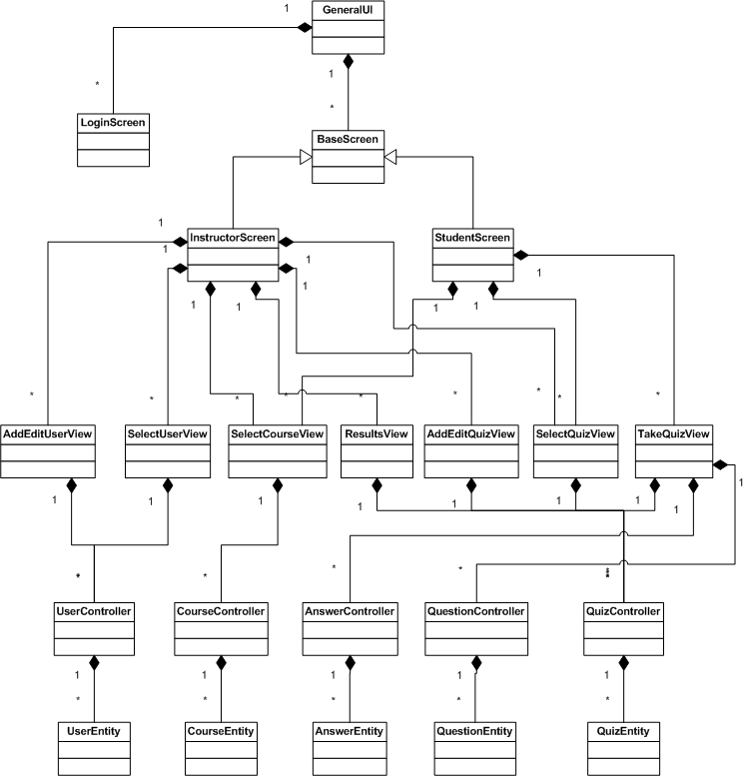
Phase III Class Diagram

Slide 8
Conclusion – What We Learned
Time is the enemy
Communication is paramount
All for one and one for all

